Slide 1
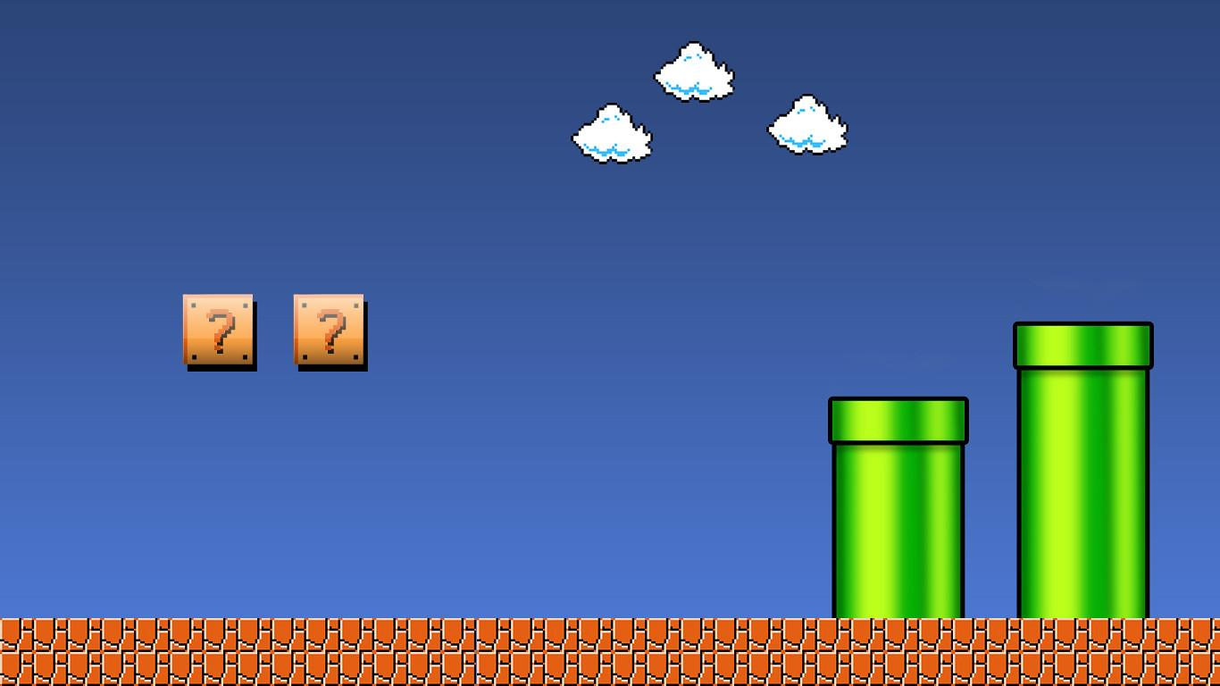
Jump, Run and Learn: Reinforcement Learning Take on SuperMario Bros
Team: P24
Parashara | A0285647M | E1216292
Sriram | A0276528R | E1132261
Xian He | A0268425X | E1101724
Grace Ngu Sook Ern | A0268281X | E1101580

Slide 2
Agenda
SuperMario Bros Environment & Scope
Project Objective
Training Setup
Understand DQN vs. PPO vs. A2C: Concept & Implementation
Goal 1: Battle of the Models: DQN vs. PPO vs. A2C
Goal 2: Custom Reward Function vs. Regular Reward Function
Goal 3: Generalizability Test
Conclusion

Slide 3
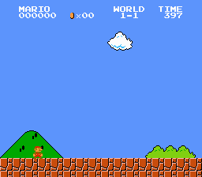
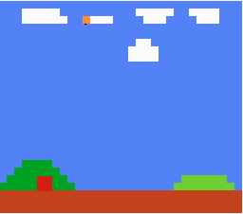
SuperMario Bros Environment & Scope
Mode | Coin-Collector (CC) | Regular
World-Stage | 1-1, 1-2
Version | 3 (Rectangular mode is selected due to easier training )
Action Space | COMPLEX_MOVEMENT from OpenAI Gym Example: {L, R, Jump, Down, No-Op, …}
State | Pixels (Skip Frame, Grayscale, Resize, Stack Frame)
Reward Function | How far right, speed, death, score (coins, enemy, etc.) | How far right, speed, death

Slide 4
Project Objective
This project aims to study DQN vs. PPO vs. A2C on a single agent complex environment in 3 depths:
Goal 1: Battles of the models: DQN vs. PPO vs. A2C
Qualitative Analysis: Video Evaluation
Quantitative Analysis: Tensorboard Logs Evaluation
Goal 2: Custom reward function vs. Regular reward function
For each algo, compare behavioral differences between having environment with coin as a reward vs. no coins
Goal 3: Generalizability Test
Compare model’s performance on unseen stage world 1-2

Slide 5
Training Setup
Mode | DQN | PPO | A2C
Package | Stable Baseline 3
Modes Trained | Both CC and Regular Mode
Training Steps | 5 million | ~2.5 million | 600k
Video Evaluation | 3 success plays, 3 failure plays
Training Evaluation | Tensorboard Logs (Exploration rate, Entropy Loss, Policy Loss and Value Loss), Best Reward, Average Reward
Testing Evaluation | Pass Count per 1000 plays, Coins Collected per 1000 plays

Slide 6
Understanding DQN vs. PPO vs. A2C: Concept & Implementation
Model | DQN | PPO | A2C
Model type | Value-based | Policy-based | Actor-Critic
Algorithm Concept | Estimate Q-value of taking an action | Directly learns policy mapping states to action | Estimate the advantage of taking certain action by learning an actor (policy) and a critic (value) b
Sample efficiency & Stability Technique | Experience replay & target network | Clipped surrogate objective & entropy regularization | Parallel environments & Advantage loss

Slide 7
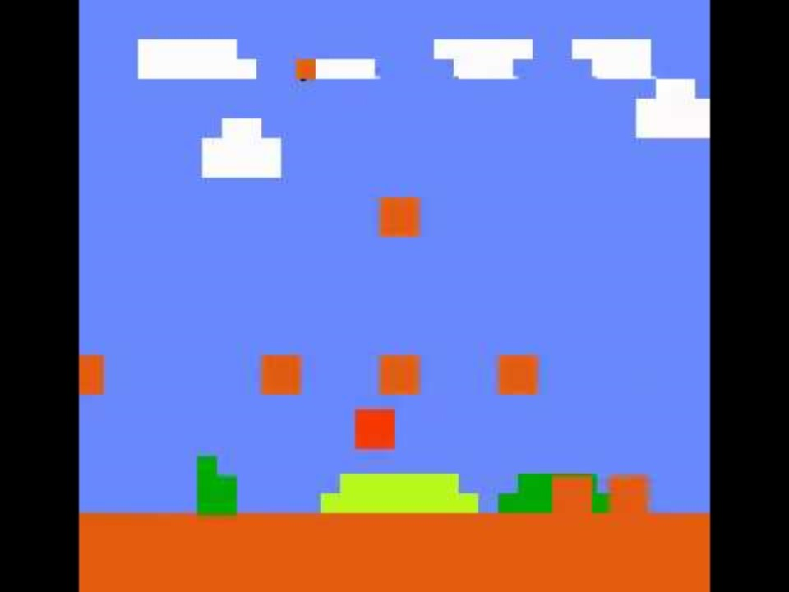
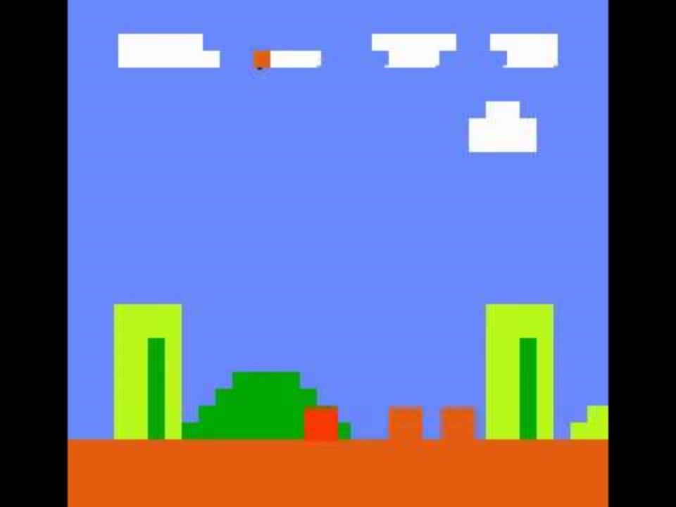
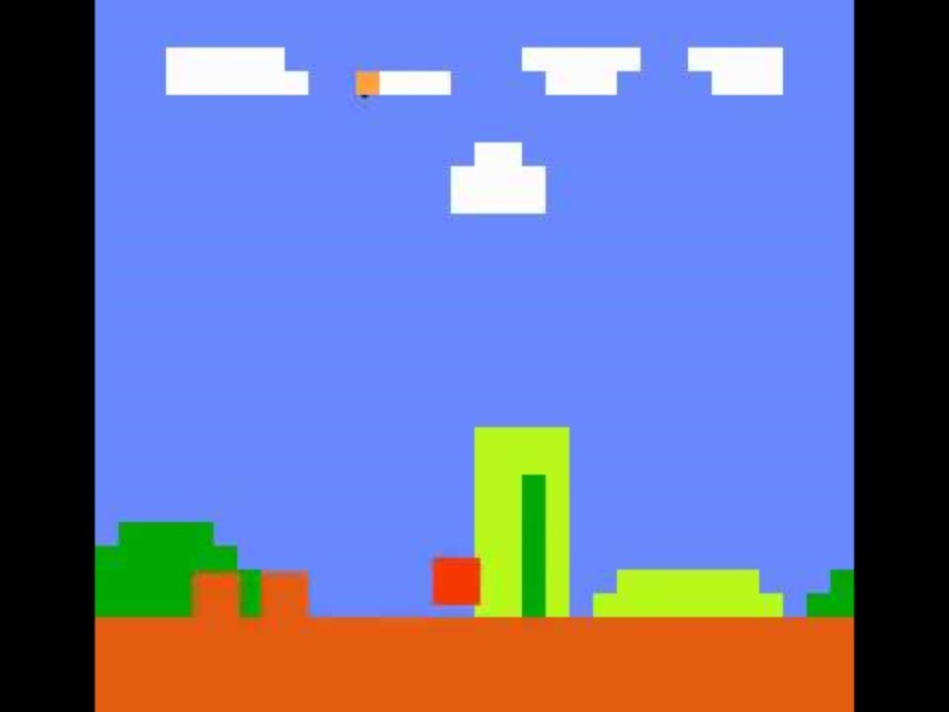
Goal 1: Battle of the Models (Video Evaluation)
DQN
PPO
A2C
DQN (20s): Conservative, trapped in local optima (pauses long before pipes and stairs) but occasional exploration help agent jump over obstacles but possibly run into monsters or cliffs
PPO (16s): Moderately conservative, does not get trapped in local optima as much as DQN but tends to avoid monsters -> Lesser coins collected
A2C (16s): Risk seeking, maximizes the coin gathered by crushing monsters and prefers to time the jumps

Slide 8
Understanding DQN vs. PPO vs. A2C: Behavioural traits
Model | DQN | PPO | A2C
Risk level | Conservative | Moderately conservative | Risk-seeking
Movements | Simple maneuvers (Non-precise) | Smoother and fluid movement | Complex maneuvers
Repetitive Behavior | Yes | No | No
Sample efficiency | High | Moderate | Low

Slide 9
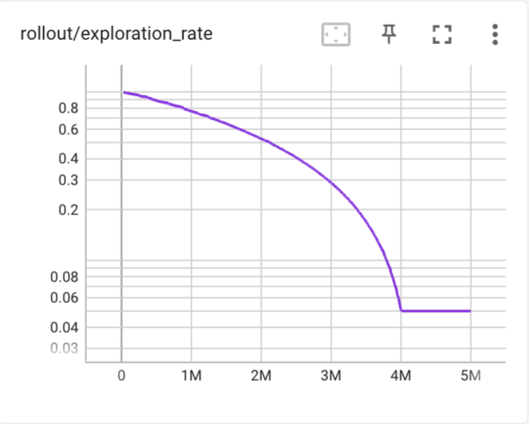
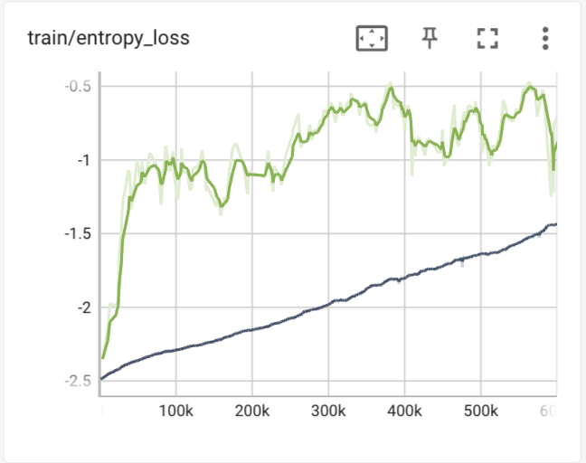
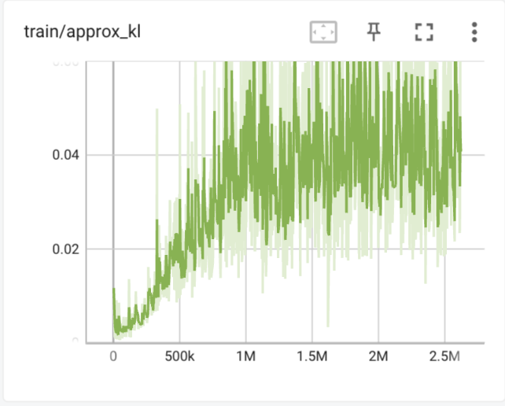
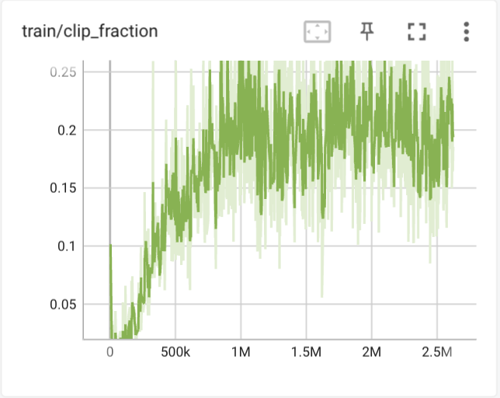
Goal 1: Battle of the Models (Exploration vs. Exploitation)
DQN: starts with high exploration and then to exploitation due to ε-greedy strategy
PPO: increases sharply to achieve high exploration then gradually increase later.PPO’s entropy loss fluctuates as it has a clipping mechanism that clips it’s policy changes. It encourages taking large updates without going too far.
A2C: slow increases exploration
2
1
3
2
2
Legend: — DQN – PPO – A2C
Notes:
So after studying the results from the evaluation, we would like to supplement the behavior traits observed with what we analyse in the training tensorboard logs
Read the slides

Slide 10
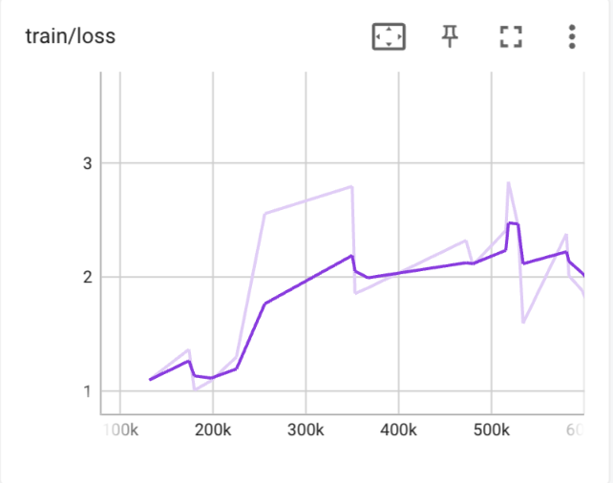
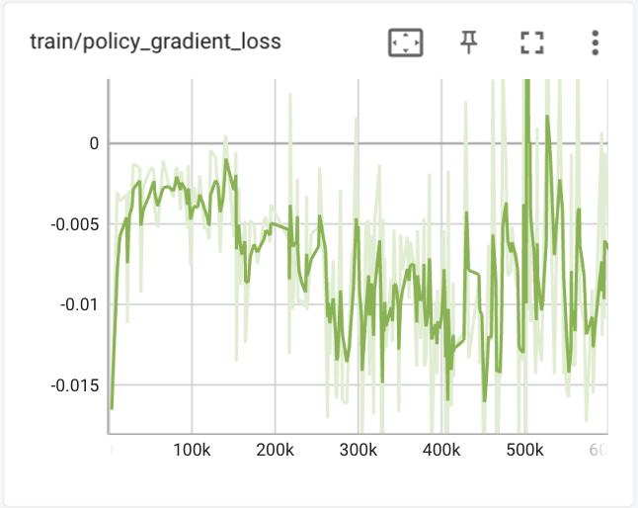
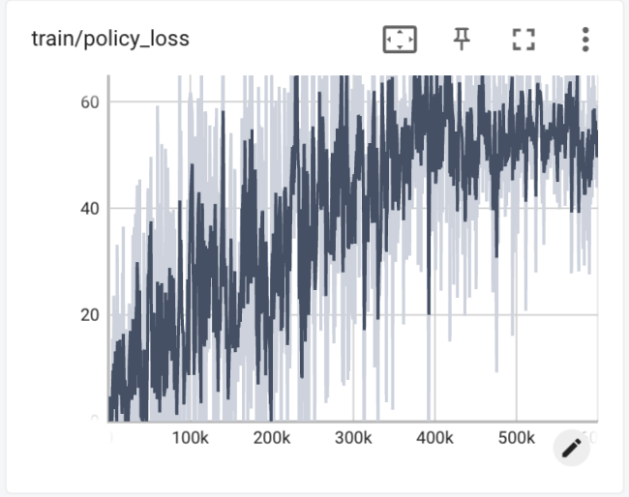
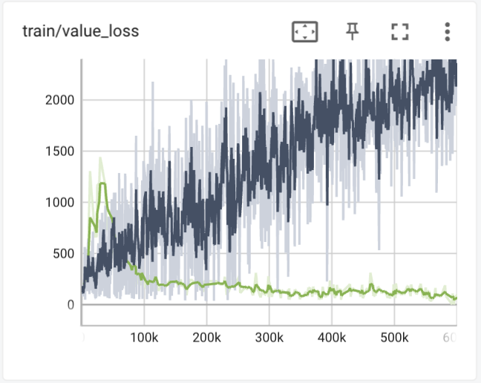
Goal 1: Battle of the Models (Policy & Value)
DQN: Overall loss increases over time. It may indicate agent has not explored enough in the early stages and make poor actions later.
PPO: Policy gradient loss decreases but increases again while value loss decreases indicate policy updates are too aggressive, causing policy to move away from optimal policies.
A2C: Policy and value loss increases over time. Model is diverging from the optimal policy.
2
1
3
2
3
Legend: — DQN – PPO – A2C

Slide 11
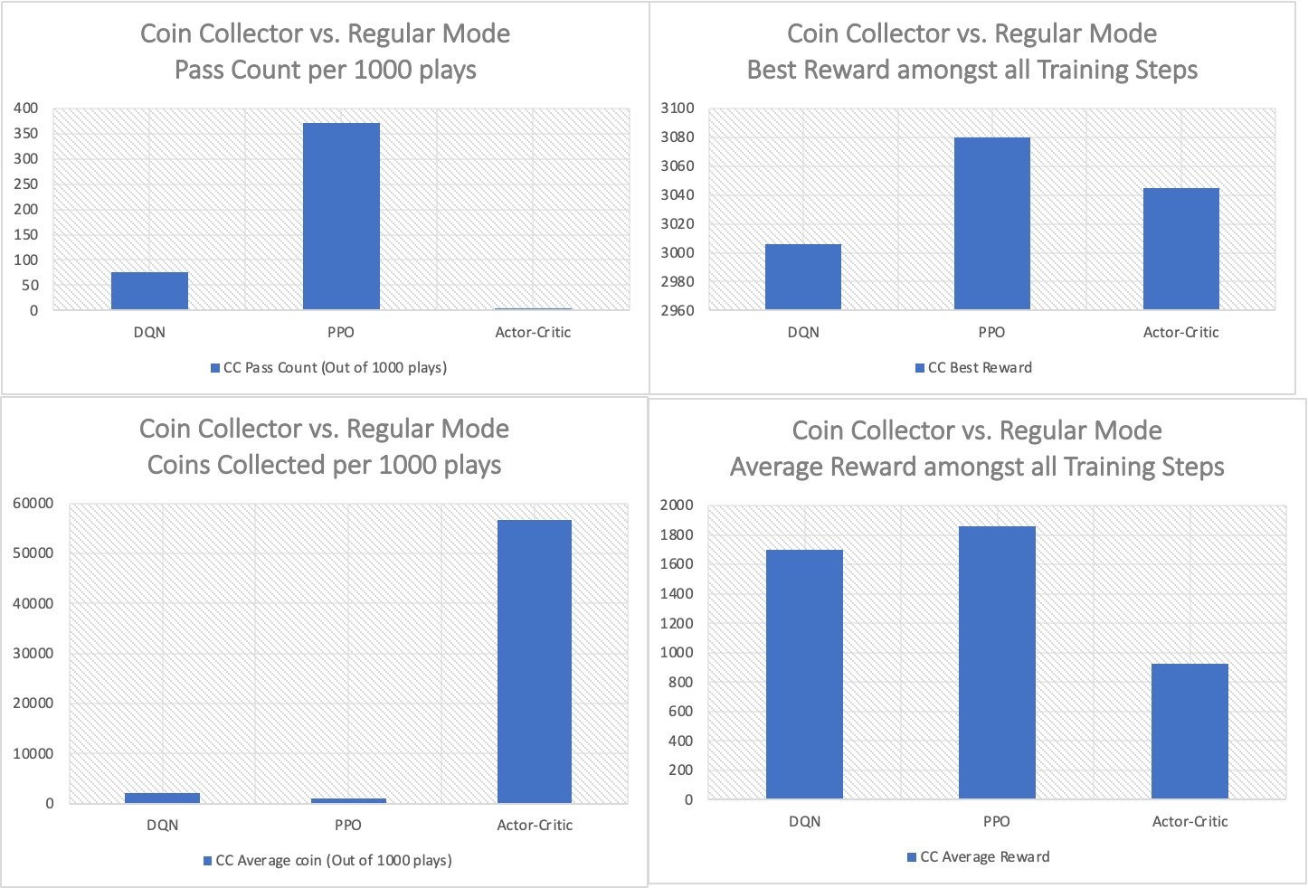
Goal 1: Battle of the Models (Pass Count, Coins Collected, Training Best & Average Reward)
1
3
Most rounds completed: PPO > DQN > A2C
Coins collected: A2C > DQN > PPO
PPO outperforms DQN with lesser training steps (2.5 mil vs. 5 mil)
A2C showing higher best reward as compared to DQN due to the large number of coins collected
2
3

Slide 12
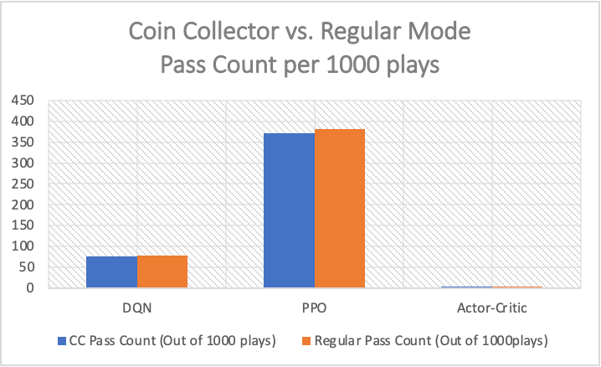
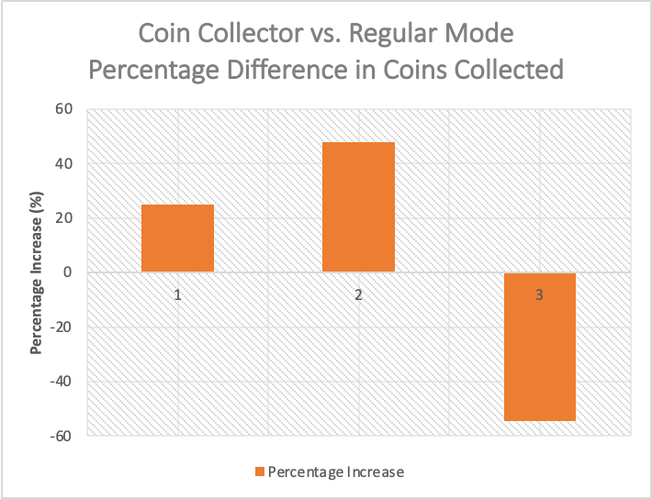
Goal 2: Custom Reward Function vs. Regular Reward Function
Using the CC mode led to higher coins collected as compared to regular mode when the agent is trained on CC mode.
While the pass rate stays almost the same.
Notes:
Change to % increase. Use bar charts instead of line charts

Slide 13
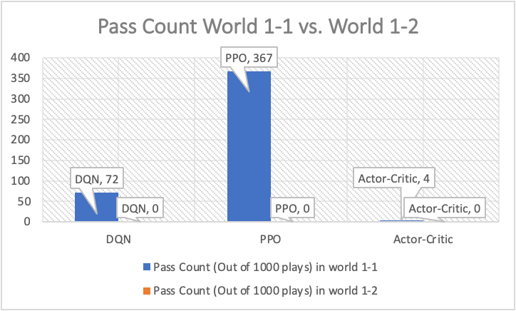
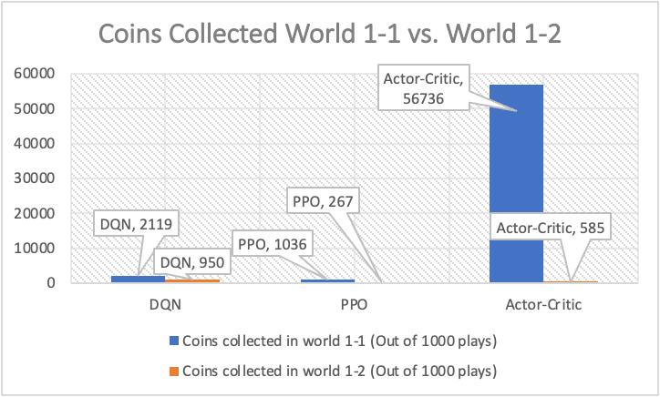
Goal 3: Generalizability Test
All algorithms did not generalize well to other stages,
All algos have a pass counts of 0/1000 in unseen terrains
All algos have a drastic reduction of coins collected in unseen terrains
Coins collected: A2C > PPO > DQN

Slide 14
Conclusion
Overall the behavior of the models match the theoretical concepts of the models:
Goal 1 Outcome (Compare between models):
Conservative: DQN > PPO > A2C
Most rounds completed: PPO > DQN > A2C
Coins collected: A2C > DQN > PPO
Goal 2 Outcome (CC mode vs. Regular mode):
CC reward altered agent’s behaviors, encouraging them to be more active in collecting coins and defeating enemies
CC reward maintained similar pass rate
Goal 3 Outcome (Generalizability):
Moderate generalizability in seen terrain and enemies
Did not generalize to unseen enemies

Slide 15
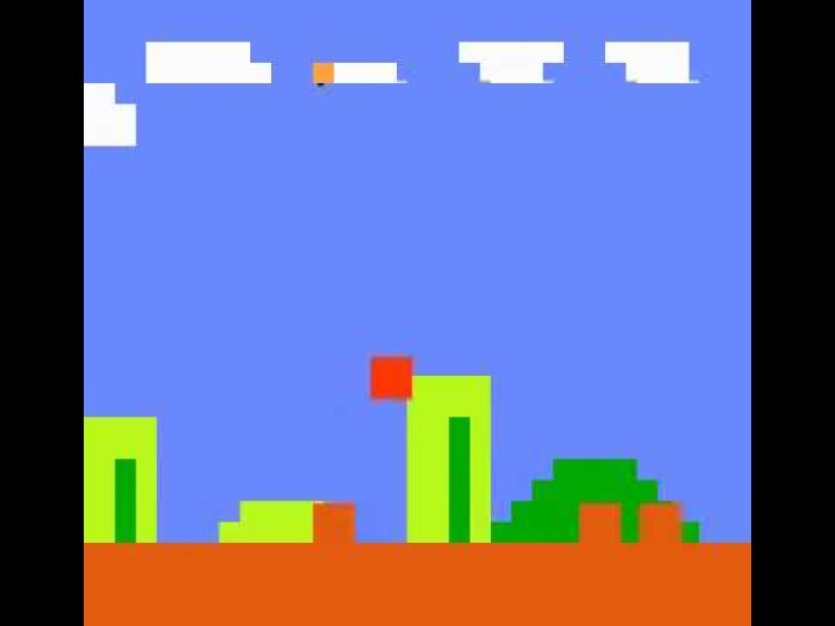
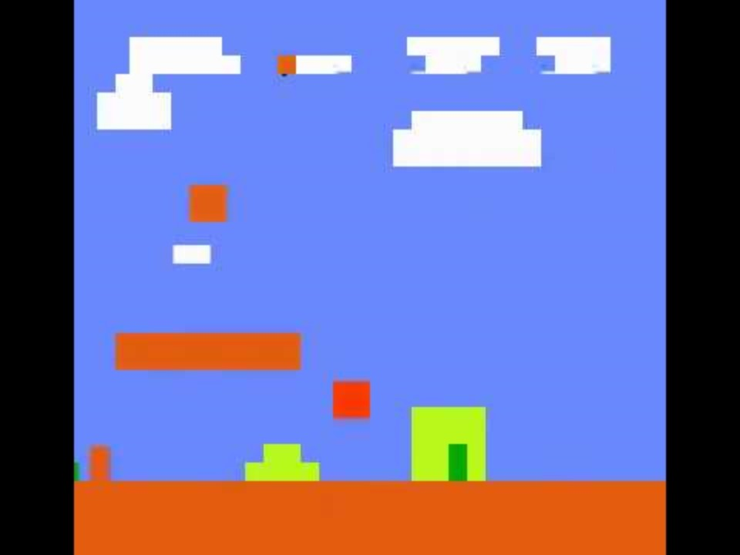
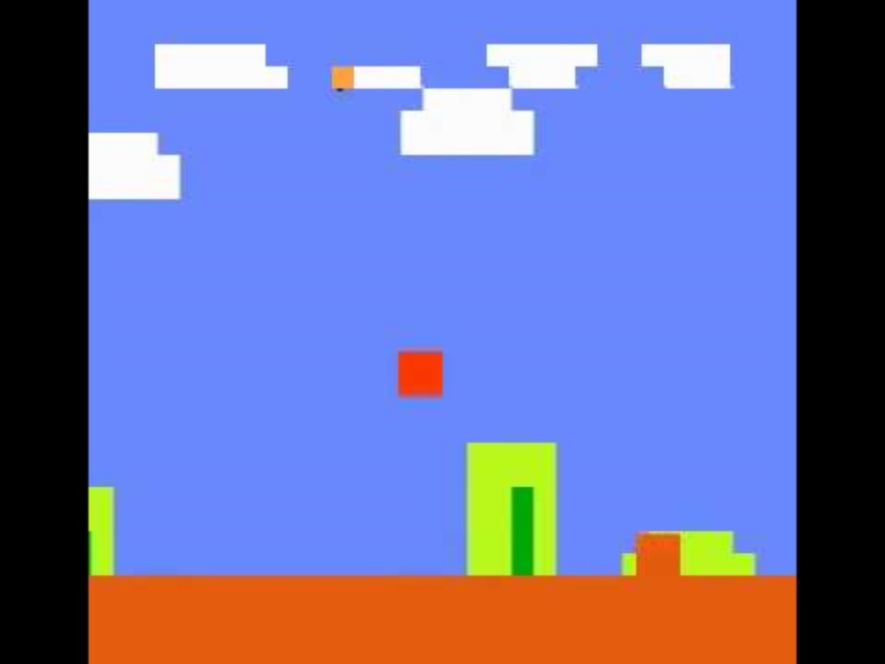
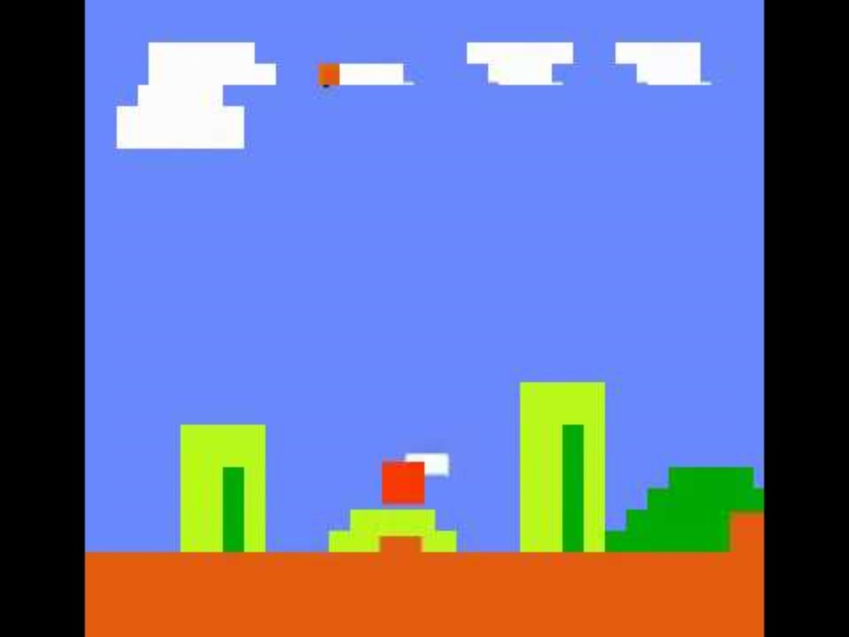
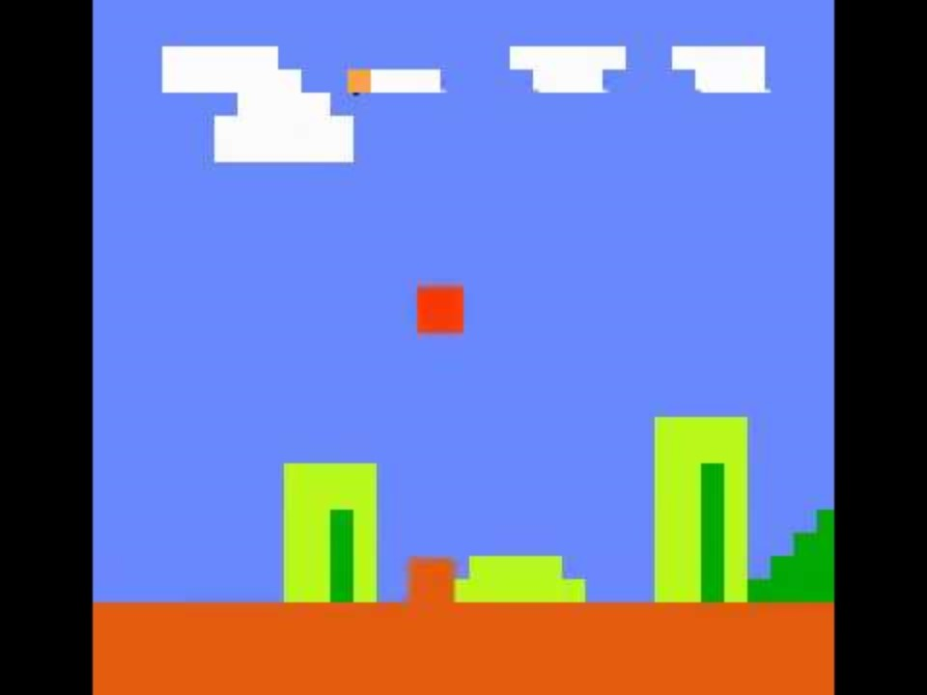
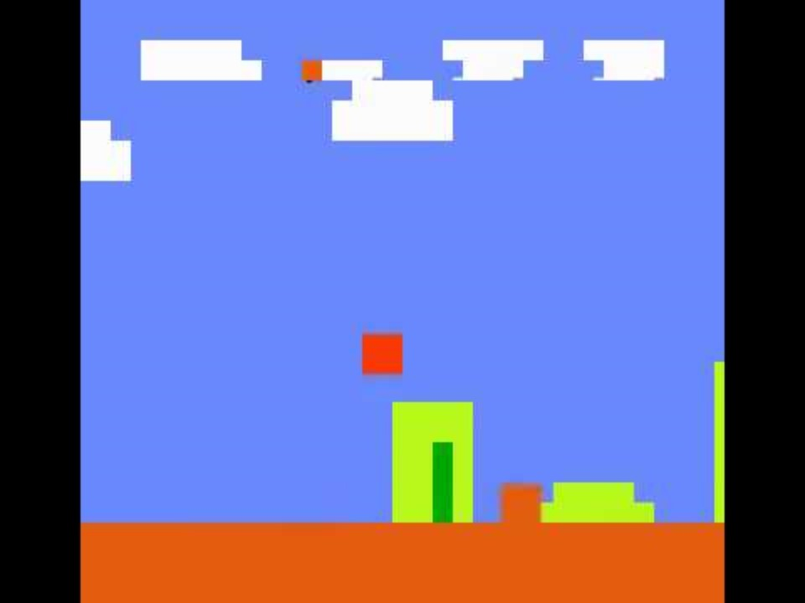
Thank you! Any Q&A? *(Here are some bloopers)

